Slide 1
Data Cube Computation

Slide 2
Cube: A Lattice of Cuboids
all
0-D(apex) cuboid
time
item
location
supplier
1-D cuboids
time,location
item,location
location,supplier
time,item
2-D cuboids
time,supplier
item,supplier
time,location,supplier
3-D cuboids
time,item,location
time,item,supplier
item,location,supplier
4-D(base) cuboid
time, item, location, supplier

Slide 3
Efficient Computation of Data Cubes
Preliminary cube computation tricks (Agarwal et al’96)
Computing full/iceberg cubes: 3 methodologies
  Top-Down: Multi-Way array aggregation (Zhao,Deshpande & Naughton, SIGMOD’97)
  Bottom-Up:
    Bottom-up computation: BUC (Beyer & Ramarkrishnan, SIGMOD’99)
    H-cubing technique (Han, Pei, Dong & Wang: SIGMOD’01)
  Integrating Top-Down and Bottom-Up:
    Star-cubing algorithm (Xin, Han, Li & Wah: VLDB’03)
High-dimensional OLAP: A Minimal Cubing Approach
Computing alternative kinds of cubes:
  Partial cube, closed cube, approximate cube, etc.

Slide 4
Preliminary Tricks (Agarwal et al. VLDB’96)
Sorting, hashing, and grouping operations are applied to the dimension attributes in order to reorder and cluster related tuples
Aggregates may be computed from previously computed aggregates, rather than from the base fact table
  Smallest-child: computing a cuboid from the smallest, previously computed cuboid
  Cache-results: caching results of a cuboid from which other cuboids are computed to reduce disk I/Os
  Amortize-scans: computing as many as possible cuboids at the same time to amortize disk reads
  Share-sorts: sharing sorting costs cross multiple cuboids when sort-based method is used
  Share-partitions: sharing the partitioning cost across multiple cuboids when hash-based algorithms are used

Slide 5
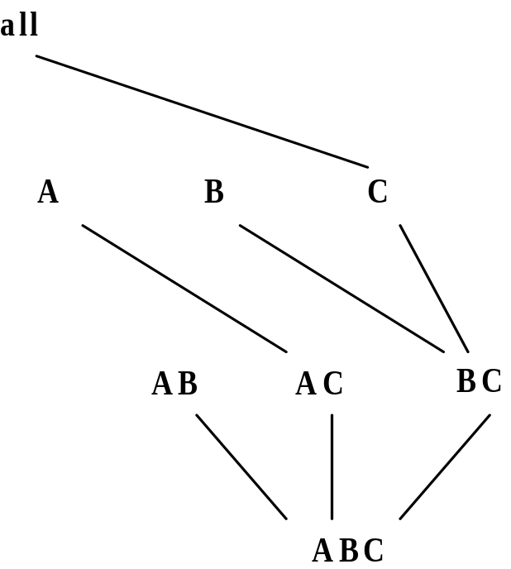
Multi-Way Array Aggregation
Array-based “bottom-up” algorithm
Using multi-dimensional chunks
No direct tuple comparisons
Simultaneous aggregation on multiple dimensions
Intermediate aggregate values are re-used for computing ancestor cuboids
Cannot do Apriori pruning: No iceberg optimization

Slide 6
Multi-way Array Aggregation for Cube Computation (MOLAP)
Partition arrays into chunks (a small subcube which fits in memory).
Compressed sparse array addressing: (chunk_id, offset)
Compute aggregates in “multiway” by visiting cube cells in the order which minimizes the # of times to visit each cell, and reduces memory access and storage cost.
C
c3
61
62
63
64
c2
45
46
47
48
c1
29
30
31
32
What is the best traversing order to do multi-way aggregation?
c 0
B
60
b3
13
14
15
16
44
9
28
56
b2
B
40
24
52
b1
5
36
20
b0
1
2
3
4
a0
a1
a2
a3
A

Slide 7
Multi-way Array Aggregation for Cube Computation
C
c3
61
62
63
64
c2
45
46
47
48
c1
29
30
31
32
c 0
B
60
b3
13
14
15
16
44
B
9
28
56
b2
40
5
24
52
b1
36
20
b0
1
2
3
4
a0
a1
a2
a3
A

Slide 8
Multi-way Array Aggregation for Cube Computation
C
c3
61
62
63
64
c2
45
46
47
48
c1
29
30
31
32
c 0
B
60
b3
13
14
15
16
44
B
9
28
56
b2
40
5
24
52
b1
36
20
b0
1
2
3
4
a0
a1
a2
a3
A

Slide 9
Multi-Way Array Aggregation for Cube Computation (Cont.)
Method: the planes should be sorted and computed according to their size in ascending order
  Idea: keep the smallest plane in the main memory, fetch and compute only one chunk at a time for the largest plane
Limitation of the method: computing well only for a small number of dimensions
  If there are a large number of dimensions, “top-down” computation and iceberg cube computation methods can be explored

Slide 10
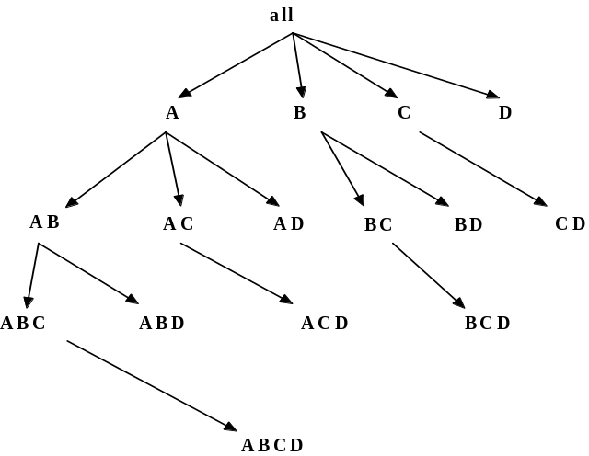
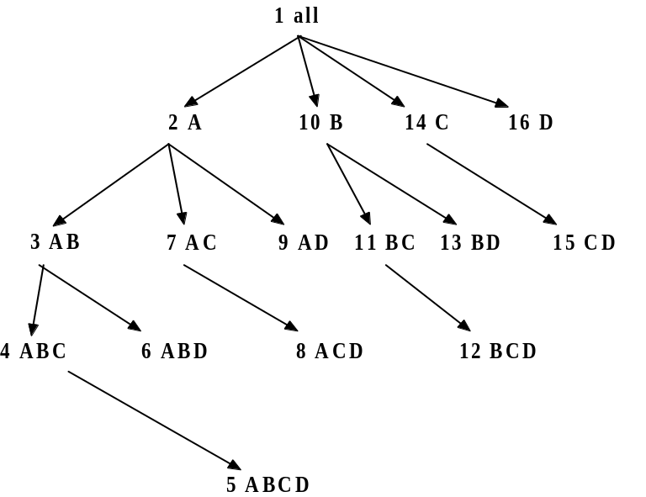
Bottom-Up Computation (BUC)
BUC (Beyer & Ramakrishnan, SIGMOD’99)
Bottom-up cube computation
  (Note: top-down in our view!)
Divides dimensions into partitions and facilitates iceberg pruning
  If a partition does not satisfy min_sup, its descendants can be pruned
  If minsup = 1 ⇒ compute full CUBE!
No simultaneous aggregation

Slide 11

BUC: Partitioning
Usually, entire data set can’t fit in main memory
Sort distinct values, partition into blocks that fit
Continue processing
Optimizations
  Partitioning
    External Sorting, Hashing, Counting Sort
  Ordering dimensions to encourage pruning
    Cardinality, Skew, Correlation
  Collapsing duplicates
    Can’t do holistic aggregates anymore!

Slide 12
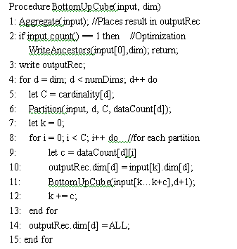

Slide 13
BUC Algorithm
{}
{}
A
A
B
C
AB
ABC
AC
B
C
C
B
BC
C
C

Slide 14
Example
call(1)
call(2)
call(3)
Cell:{all}
Cell:{a1}
Cell:{a1b1}
Cell:{a1b1c3}
a1b1c3
a1b1c4
a3b2c1
a1b1c3
a1b1c4
a1b1c3
a1b1c4
a1b1c3
call(4)
call(5)
Tuple partition
Cell:{a1b1c4}
Cell:{a3}
a1b1c4
Cell:{a1c3}
Step(0)
Cell:{b1}
a1b1c3
…
…
Cell:{c4}
Cell:{a1c4}

Slide 15
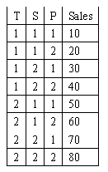
BUC Algorithm
{}
{}
A
A
B
C
AB
ABC
B
C
C
AC
B
BC
C
C

Slide 16
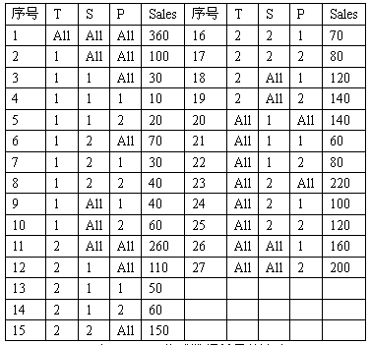

Slide 17
BUC Algorithm
适合稀疏数据
可以共享排序
当划分只有一个元组时不需要继续划分

Slide 18
Pipe Line Algorithm
生成流水线的算法
ABC➔AB➔A➔{}
BC➔B
AC➔C

Slide 19
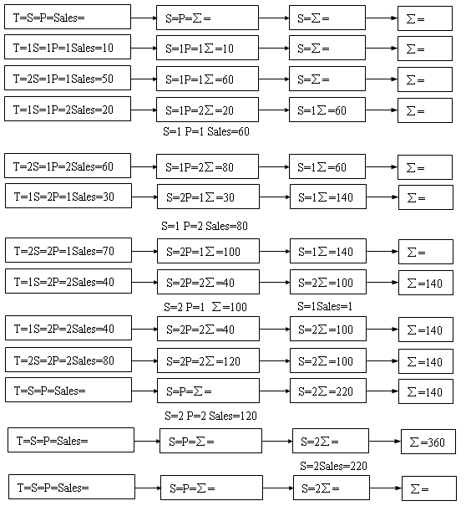

Slide 20
流水线中为每个表分配了一个存储单元，可以存放表中的一个元组。初始时，流水线中所有结点的内容为空，即最上面那条流水线。
从表（T，S，P，Sales）读入第一条记录（1，1，1，10）后，由于第二个结点为空，将该条记录的S和P两个维属性的值和度量的值都复制到第二个结点中，其它结点没有任何变化。

Slide 21
读入第二条记录（2，1，1，50）后，第二个结点不为空，但是，维属性S、P的值和第二条记录的相等，因此，把第二条记录的度量值和第二个结点的度量值累加（这里假设聚集函数是sum）。

Slide 22
读入第三条记录（1，1，2，20）后，第二个结点不为空，其内容是S=1P=1∑=60，它与当前记录在属性S和P上的值不相等，这时，首先要把第二个结点中的内容流动到第三个结点，由于第三个结点为空，就把S属性的值和度量值复制到第三个结点中。其次，将第二个结点的内容作为一条记录输出到表（S，P，Sales）。最后，将第三条记录的S和P两个维属性的值和度量的值都复制到第二个结点中。

Slide 23
当处理完表（T，S，P，Sales）的所有记录后，流水线中有些结点不为空，这时，按照从左至右的次序，把不为空结点的内容流动到下一个结点，并组织一条记录输出到对应的表中，然后清空结点，直到所有结点都为空为止。

Slide 24
Pipe Line Algorithm
可以充分的利用排序结果
主要的工作量是外排序，
容易改写成并行算法
需要的内存小（如果不考虑外排序）

Slide 25
Two Tier Pipe Line
两类维： 划分维和非划分维

Slide 26
Two Tier Pipe Line
划分维构成主流水线
AB→B→{}
A
非划分维构成次流水线
CD→D→{}
C

Slide 27
Two Tier Pipe Line
AB
A
{}
CD
D
{}
C

Slide 28
Two Tier Pipe Line
A | B | C | D | M
0 | 0 | 0 | 0 | 10
0 | 0 | 1 | 1 | 30
0 | 0 | 1 | 0 | 20
0 | 0 | 2 | 3 | 60
0 | 0 | 3 | 2 | 40
0 | 1 | 1 | 0 | 40
0 | 1 | 0 | 3 | 80
0 | 1 | 3 | 2 | 40
AB
A
{}
C | D | M
0 | 0 | 10
1 | 0 | 20
1 | 1 | 30
2 | 3 | 60
3 | 2 | 40
CD
D
{}

